Slide 1

Programming Two (csc7051)
Aidan McGowan
Generic Classes and Methods

Slide 2
Introduction
Generics are a facility of generic programming that was added to the Java programming language in 2004 as part of J2SE 5.0.
They allow a type or method to operate on objects of various types while providing compile-time type safety.
A common use of this feature is when using a Java Collection that can hold objects of any type, to specify the specific type of object you will be storing in it.

Slide 3
Generics – the motivation
In any nontrivial software project, bugs are simply a fact of life. Careful planning, programming, and testing can help reduce their pervasiveness, but somehow, somewhere, they'll always find a way to creep into your code.
Compile-time bugs, tell you immediately that something is wrong.
Runtime bugs much more problematic; they don't always surface immediately, and when they do, it may be at a point in time that's far removed from the actual cause of the problem.
Generics add stability to your code by making more of your bugs detectable at compile time

Slide 4

Motivation for Generic Methods- error catching
The following block of Java code illustrates a problem that exists when not using generics.
First, it declares an ArrayList.
Then, it adds a String to the ArrayList.
Finally, it attempts to retrieve the added String and cast it to an Integer.

Slide 5
Motivation for Generic Methods- error catching
Although the code compiles without error, it throws a runtime exception (java.lang.ClassCastException) when executing the third line of code.
This type of problem can be avoided by using generics and is the primary motivation for using generics.

Slide 6
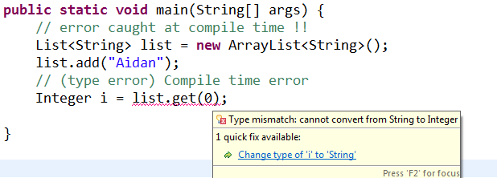
Motivation for Generic Methods- error catching
Using generics, the previous code fragment can be rewritten as follows:

Slide 7
Motivation for Generic Methods- error catching
The type parameter String within the angle brackets declares the ArrayList to be constituted of String (a descendant of the ArrayList's generic Object constituents).
With generics, it is no longer necessary to cast the third line to any particular type, because the result of list.get(0) is defined as String by the code generated by the compiler.
Compiling the third line of this fragment with J2SE 5.0 (or later) will yield a compile-time error because the compiler will detect that list.get(0) returns String instead of Integer.

Slide 8


Motivation for Generic Methods – replacement for method overloading
Overloaded methods are often used to perform similar operations on different types of data.

Slide 9
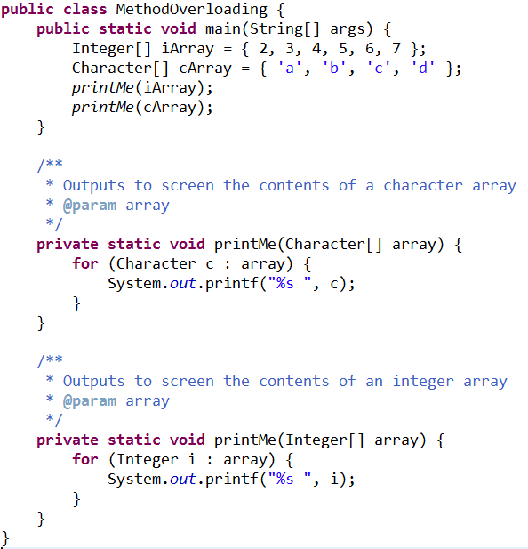
Motivation for Generic Methods – replacement for method overloading

Slide 10

Note
Primitive types cannot be used with Generics.
Why ? Anything that is used as generics has to be convertible to Object and the primitive types aren't. So they can't be used in generics.

Slide 11

Motivation for Generic Methods – replacement for method overloading
The two overloaded methods could be replaced with one method that accepts a non specific parameter. This is achieved using Generics.

Slide 12
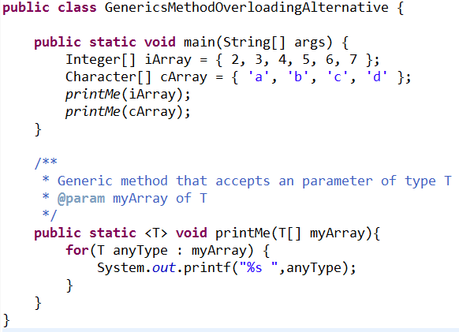
Motivation for Generic Methods – replacement for method overloading
Note : only reference types can be used with generic methods and classes

Slide 13
Generic Methods: Implementation and Compile-
Time Translation
If the operations performed by several overloaded methods are identical for each argument type, the overloaded methods can be more compactly and conveniently coded using a generic method.
You can write a single generic method declaration that can be called with arguments of different types.
Based on the types of the arguments passed to the generic method, the compiler handles each method call appropriately.

Slide 14
Generic Methods: Implementation and Compile-
Time Translation
The <T> marks the method as being generic and specifies the name of the type parameter that will be used in the definition.
All generic method declarations have a type-parameter section delimited by angle brackets (< and >) that precedes the method’s return type (< T > in this example).

Slide 15
Generic Methods: Implementation and Compile-
Time Translation
Each type-parameter section contains one or more type parameters (also called formal type parameters), separated by commas. A type parameter, also known as a type variable, is an identifier that specifies a generic type name.
The type parameters can be used to declare the return type, parameter types and local variable types in a generic method declaration, and they act as placeholders for the types of the arguments passed to the generic method, which are known as actual type arguments.

Slide 16
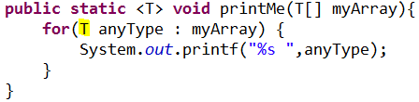
Generic Methods: Implementation and Compile-
Time Translation
A generic method’s body is declared like that of any other method. The use of T within the parameter declaration or method body is a placeholder for the argument type to be supplied to the method. In the above example the T is replaced at compile time by the type that is to be passed to the argument.

Slide 17

Erasure at Compilation Time
When the compiler translates a generic method into Java bytecode, it removes the type-parameter section and replaces the type parameters with actual types.
This process is known as erasure.

Slide 18
Type parameter used in method’s parameter list
The type-parameter names throughout the method declaration must match those declared in the type-parameter section.
While a type parameter can be declared only once in the type-parameter section but can appear more than once in the method’s parameter list.

Slide 19
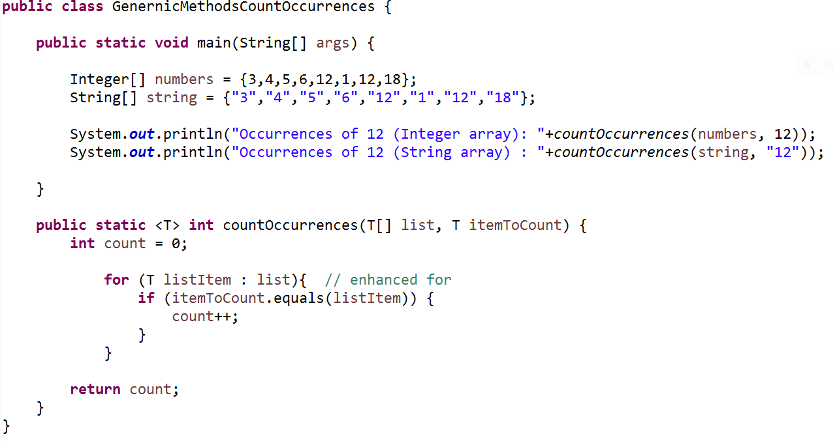

Another generic example
Method that accepts an array of T and an another argument of T and counts the occurrence of T in the array. T is replaced by an actual type (in this case Integer and then String) at compile time.

Slide 20
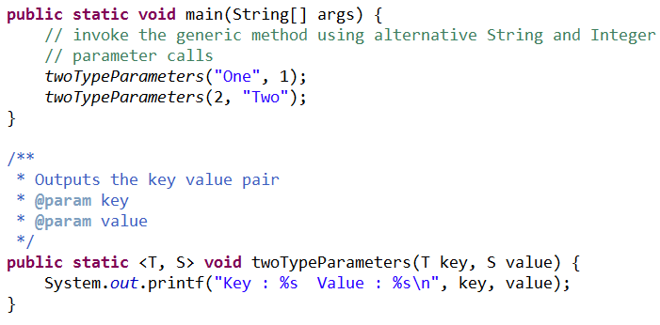

Declaring more than one type parameter
It is possible to declare and use more than one generic type parameter

Slide 21
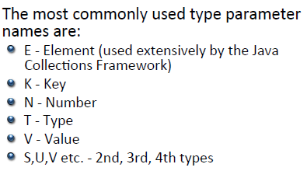
Type parameters – naming conventions

Slide 22
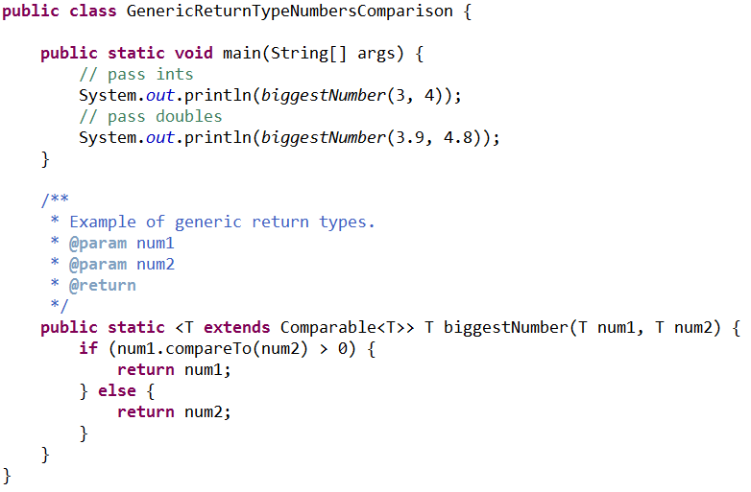
Methods That Use a Type Parameter as the Return Type
The relational operator > cannot be used with reference types.
However, it’s possible to compare two objects of the same class if that class implements the generic
interface Comparable<T>
(package java.lang).
All the type-wrapper classes for primitive types implement this interface.

Slide 23
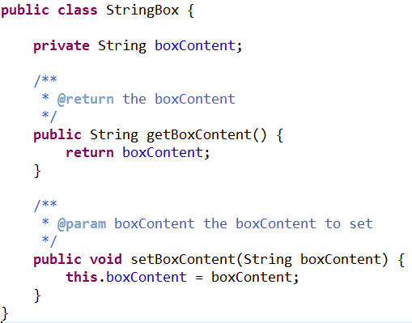
Generic classes
Classes can also exhibit generic properties.
Assume that we need to define a class named Box that stores Strings…
This Box can now only ever take a string as it’s content.

Slide 24
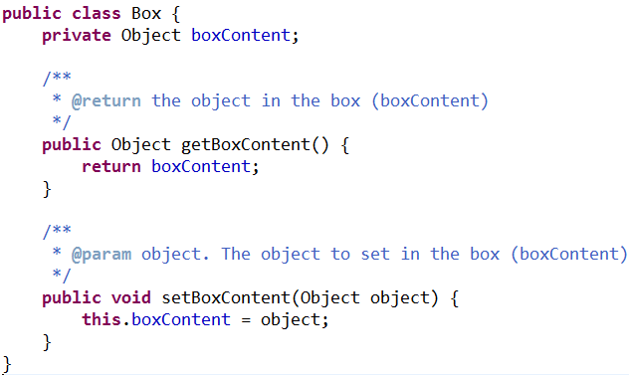
Generic classes
All classes in Java inherit from Object so let’s make the Box take Object instead of String…
More flexible but still has potential problems at compile time…

Slide 25
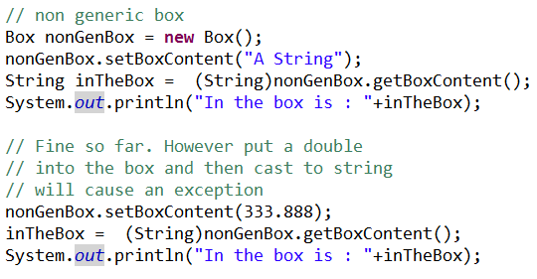
Generic classes
The Box that accepts any object as its content still has this potential failing ….

Slide 26
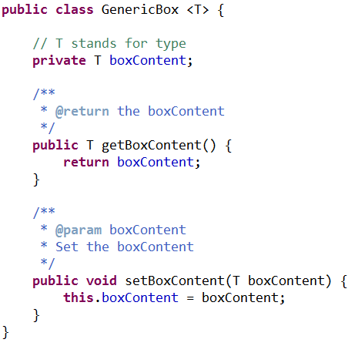
Generic classes
Generically defining the class enables similar flexibility to the previous example but includes compile time type safety.

Slide 27
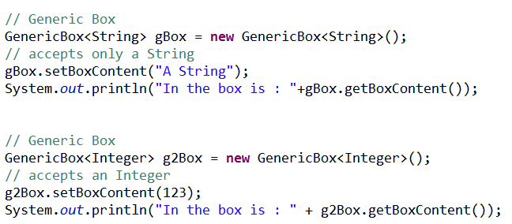

Generic classes
Generically defining the class enables similar flexibility to the previous example but includes compile time type safety.

Slide 28
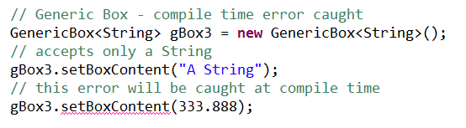
Generic classes
Compile time safety
Once you have a generic class, you can use a simple, concise notation to indicate the type(s) that should be used in place of the class’s type parameter(s). At compilation time, the compiler ensures the type safety of your code and uses the erasure techniques to enable your client code to interact with the generic class.

Slide 29
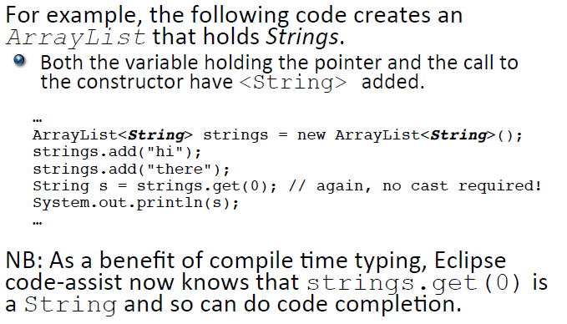
Generic classes – collections

